Slide 1
BAN 612 DATA ANALYTICS DATA ANALYST JOBS IN BAY AREA
NEHA AGRAWAL

Slide 2
Problem Statement
Web Scraping for the jobs in Data Analytics field
Clean and organize the data
Define your own skills and get a Data Frame of the jobs that matches to your skills.
Notes:
Updated by Neha

Slide 3
Data Source
Source – Indeed API Python Client Library.

Slide 4
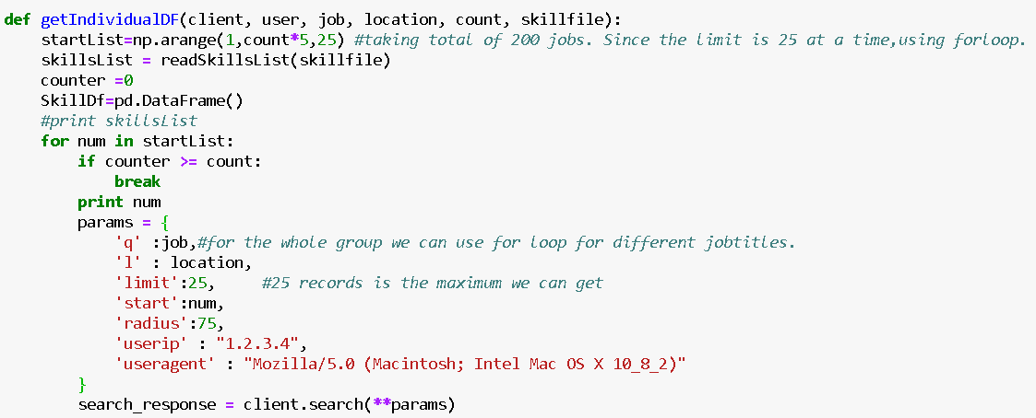
Methods Used to Scrape Data
Notes:
Updated by Neha

Slide 5
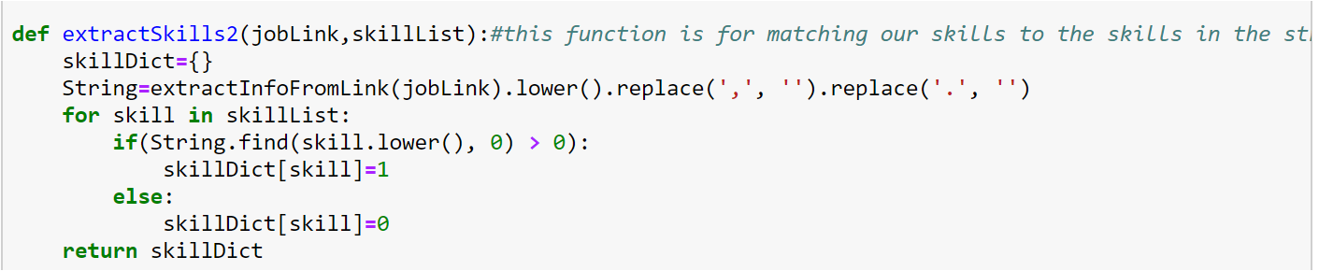
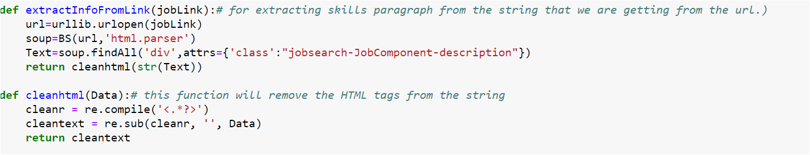
Methods Used to Scrape Data
Notes:
Updated by Neha

Slide 6
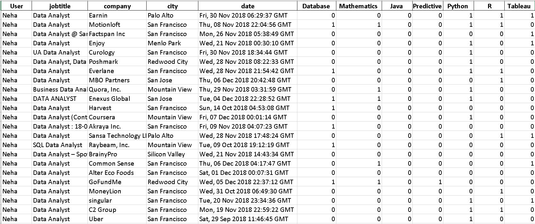
DataFrame Excel Output

Slide 7
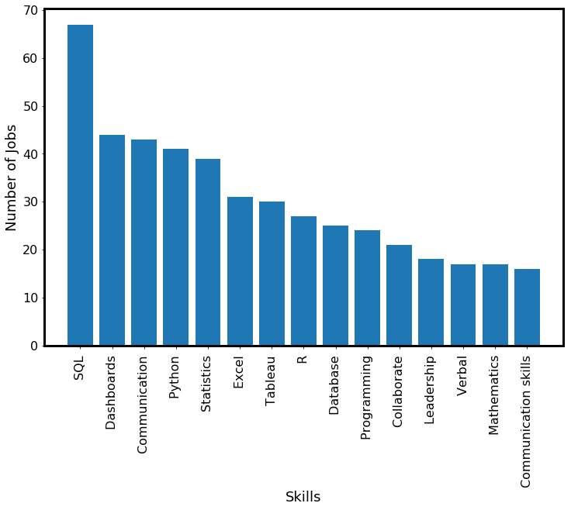
Top 15 Skills in 100 jobs

Slide 8
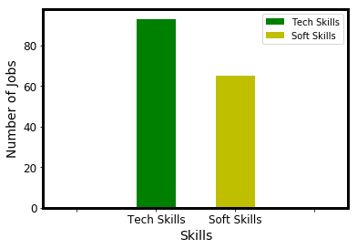
Soft skills vs Tech skills

Slide 9
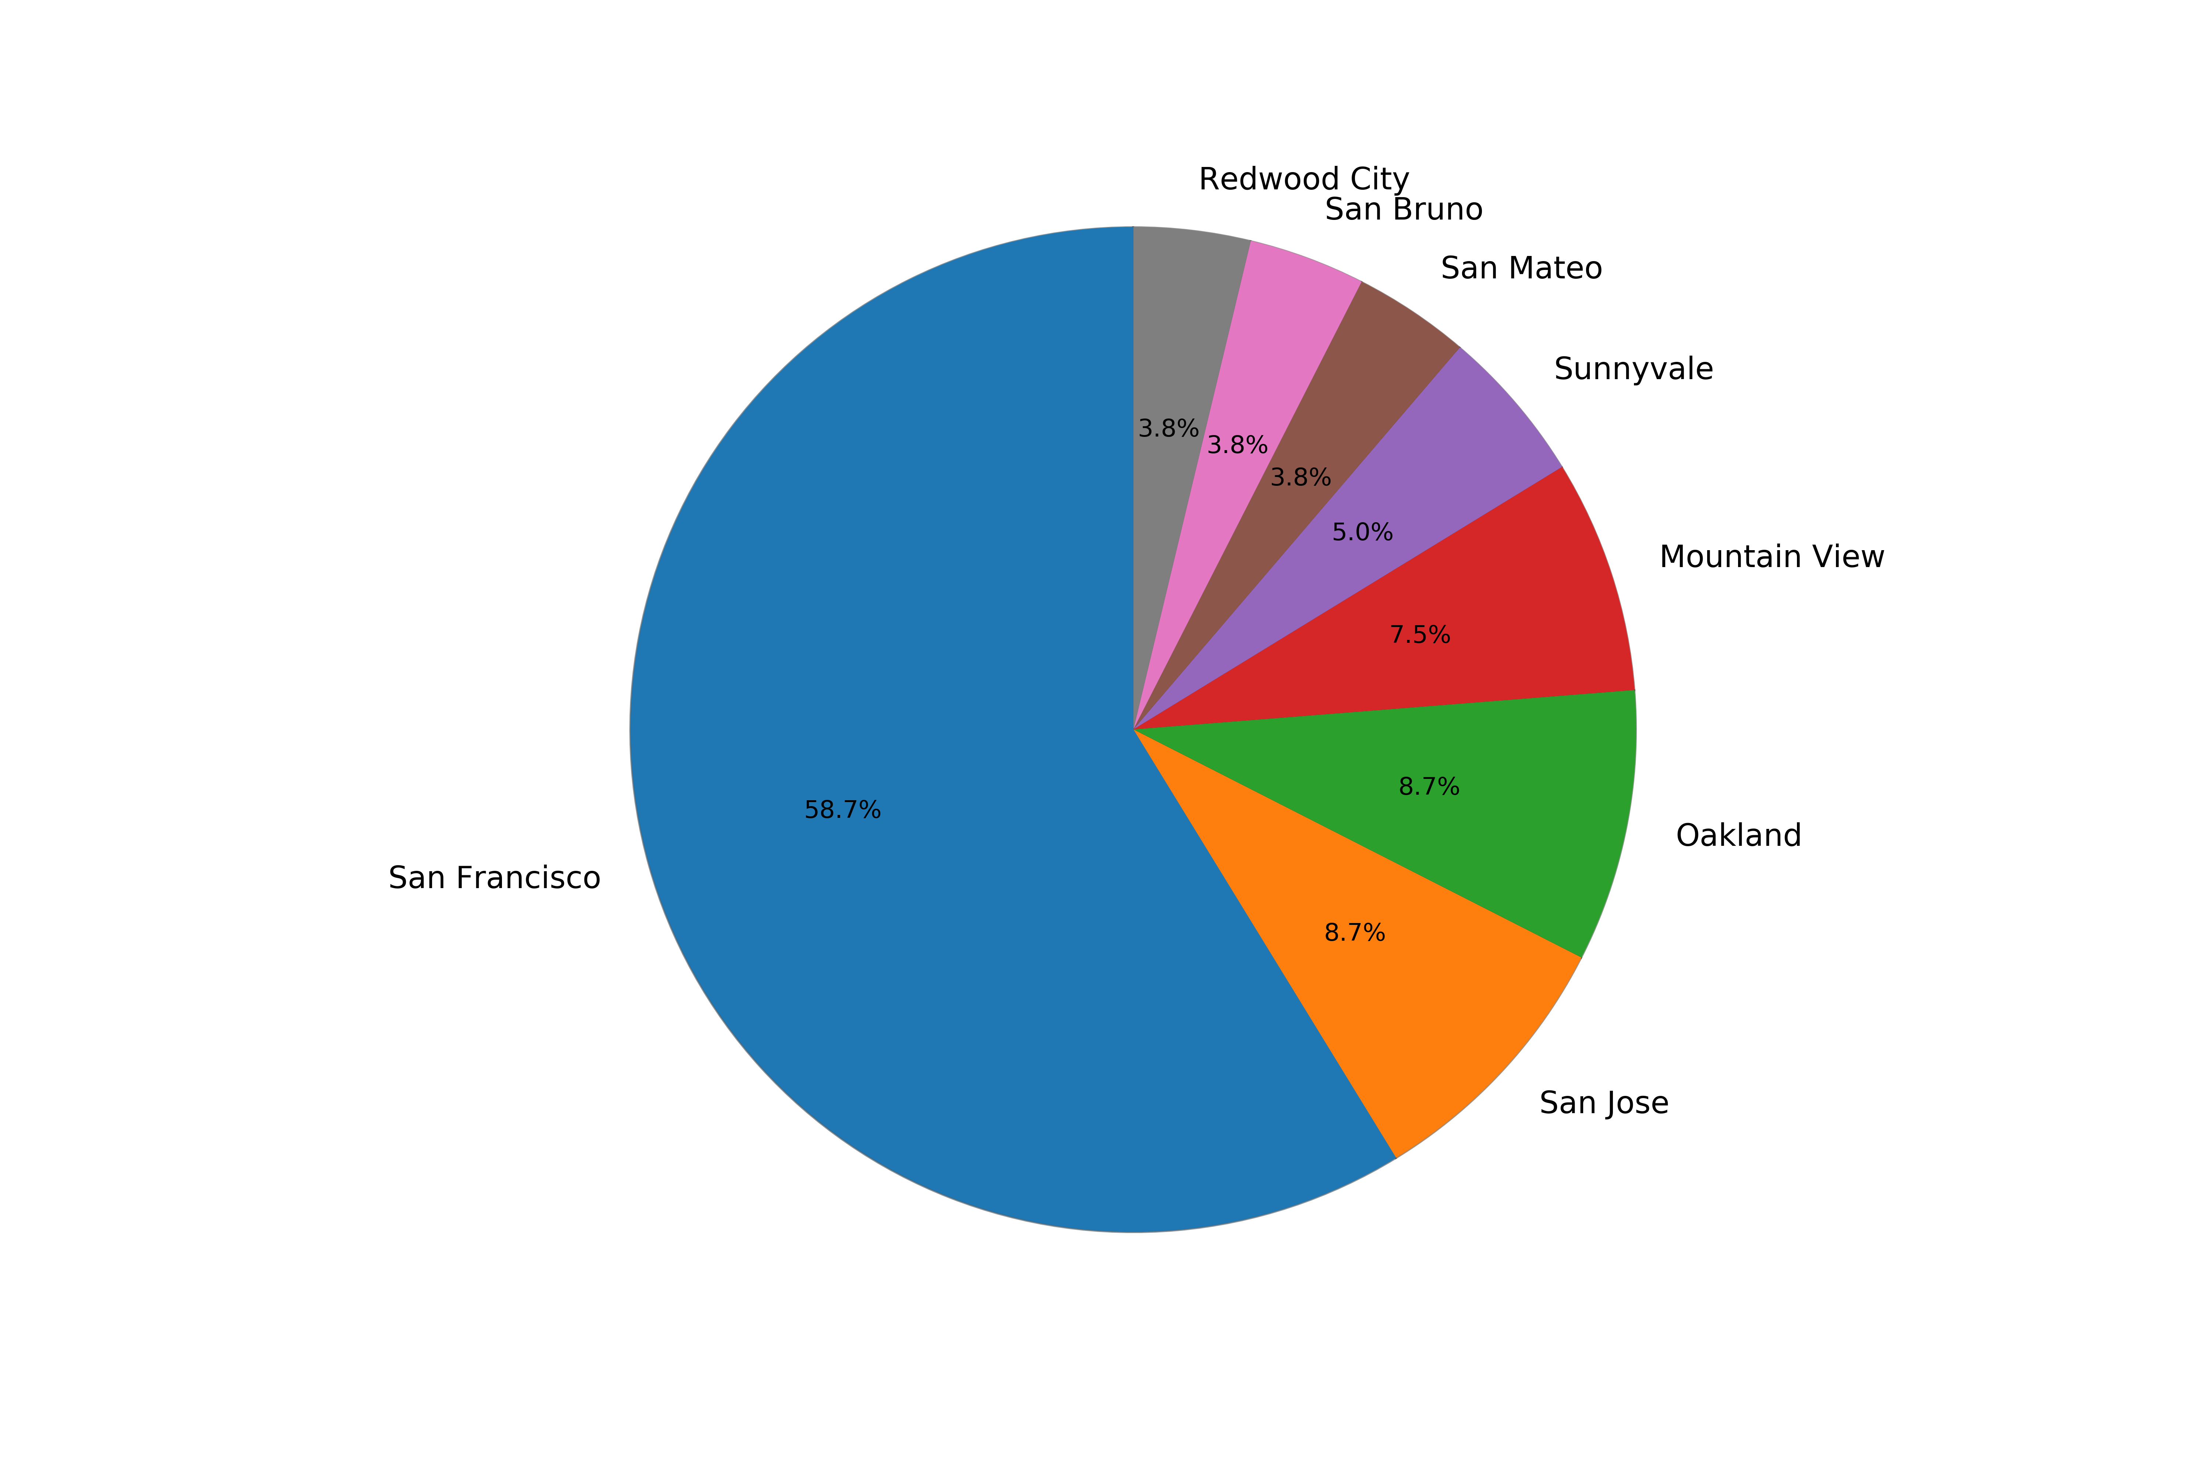
Bay Area Job Categorization

Slide 10
Conclusion
SQL, Python, Dash Boards, Statistics and Communication Skills are the top five skills for the data analyst jobs. Out of 100 jobs SQL was a required skills in the 70 Jobs.
Technical Skills were required more than the soft skills. Technical skills were required in more than 90 jobs vs soft skills were required in only 65 jobs.

Slide 11
Thank You!

